Slide 1
Savitribai Phule Pune University
Bachelor of Business Administration (Computer Application)
Academic Year: 2020 – 2021

Slide 2
Job Portal
Management System
A Project Review
By
Ankitosh Kumar & Suraj Kumar
Under semester VI
Maeer’s MIT Arts, Commerce and Science College Alandi (D)Pune-05

Slide 3
Introduction
The “Job Portal Management System” has been developed to override the problems prevailing in the practicing manual system . This software is supported to eliminate and in some cases reduces the hardships faced by this existing system. Moreover this system is designed for the particular need of the company to carry out operations in a smooth and effective manner.
The application is reduced as much as possible to avoid errors while entering the data. It also provides error messages while entering invalid data. Job Portal System(JPMS),as described above, can lead to error free , secure , reliable and fast management system . It can assist the user to concentrate on the record keeping . Thus it will help organization in better utilization of resources.

Slide 4
Modules
Login
Registration
Home Page
Search
Appointment/Form Filling
Maintenance
Utility
Financial
Reports

Slide 5
Problems With Existing System
Lack of data security.
More man power
Time consuming.
Money loss.
Consumes large volume of pare work.
Needs manual calculations.
No direct role for the higher officials.

Slide 6
Scope of the System
The objective of the proposed system is to develop a system of improved facilities. The proposed system will work according to the standards laid down by the existing system.
To develop a user-friendly system.
Security of data.
Ensecure data accuracy’s.
Proper control of the higher officials.
Minimize manual data entry.
Minimize time needed for the various processing.
To generate all the required reports accurately and promptly.
To keep a check on the data processed to avoid errors.
To ease the process of editing and updating.
To provide authorized access to the system.

Slide 7
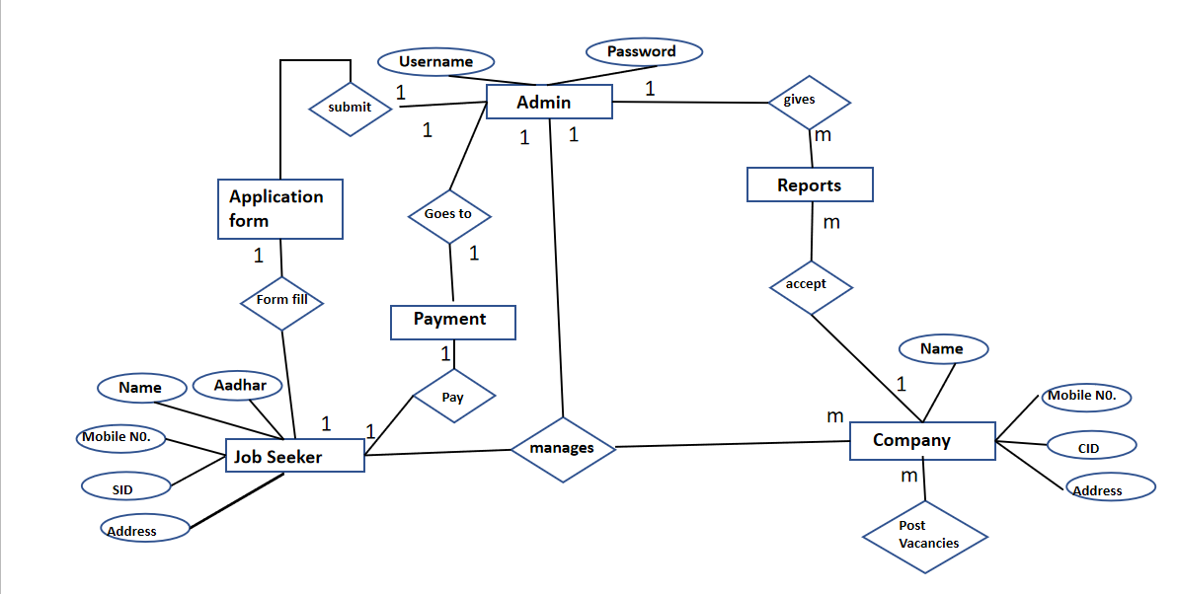
Entity Relationship Diagram

Slide 8
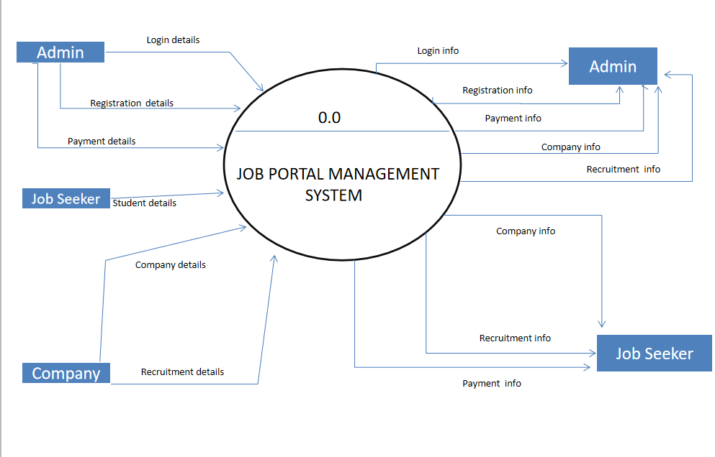
Context Level Diagram

Slide 9
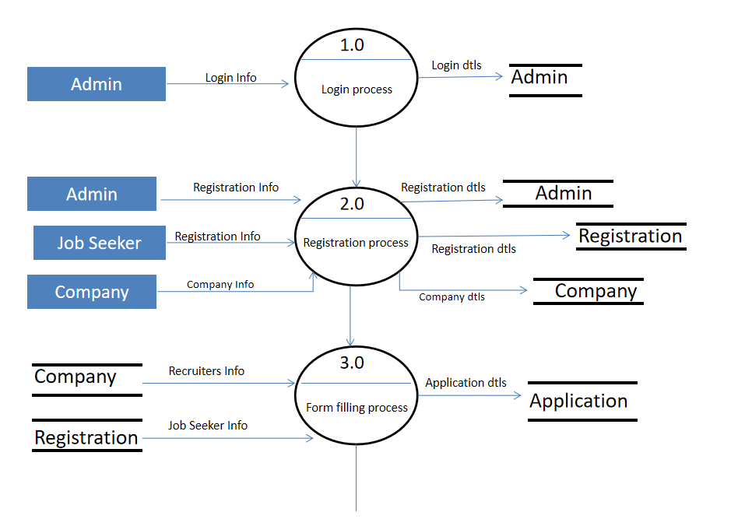
Data Flow Diagram

Slide 10
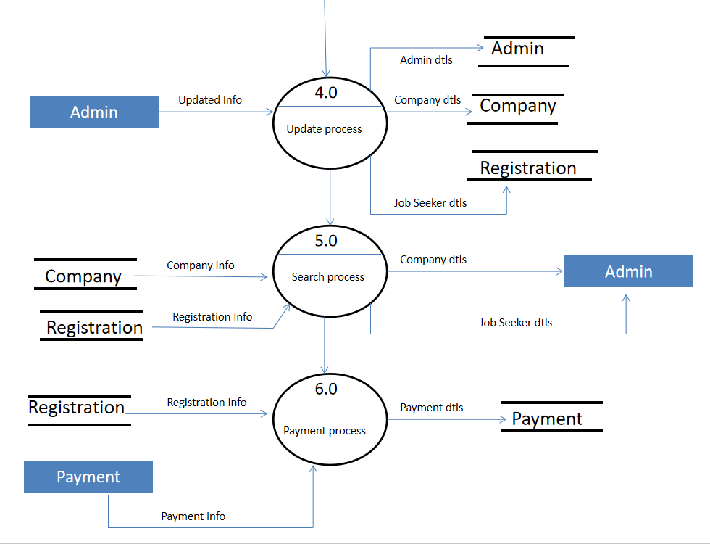
Data Flow Diagram

Slide 11
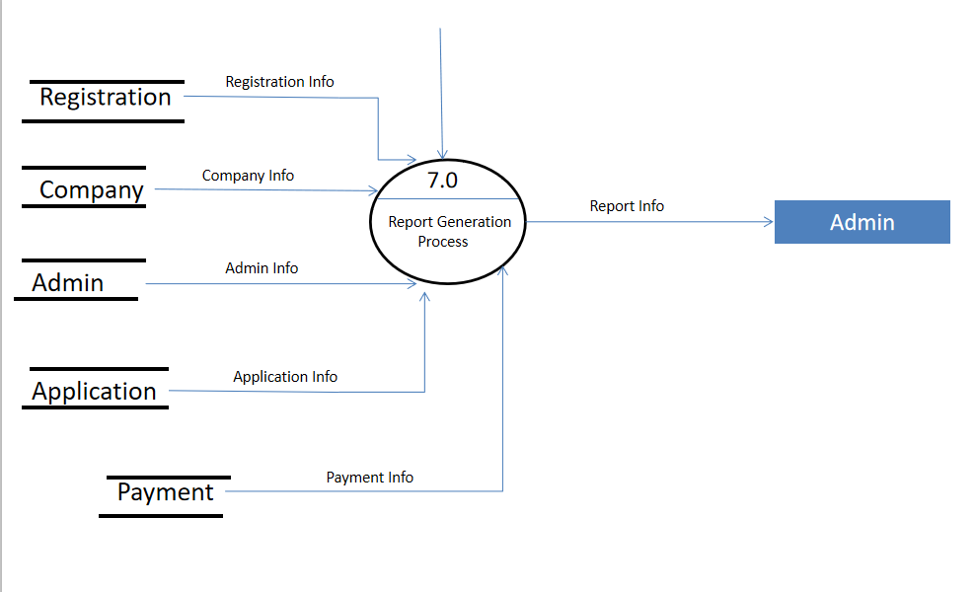
Data Flow Diagram

Slide 12
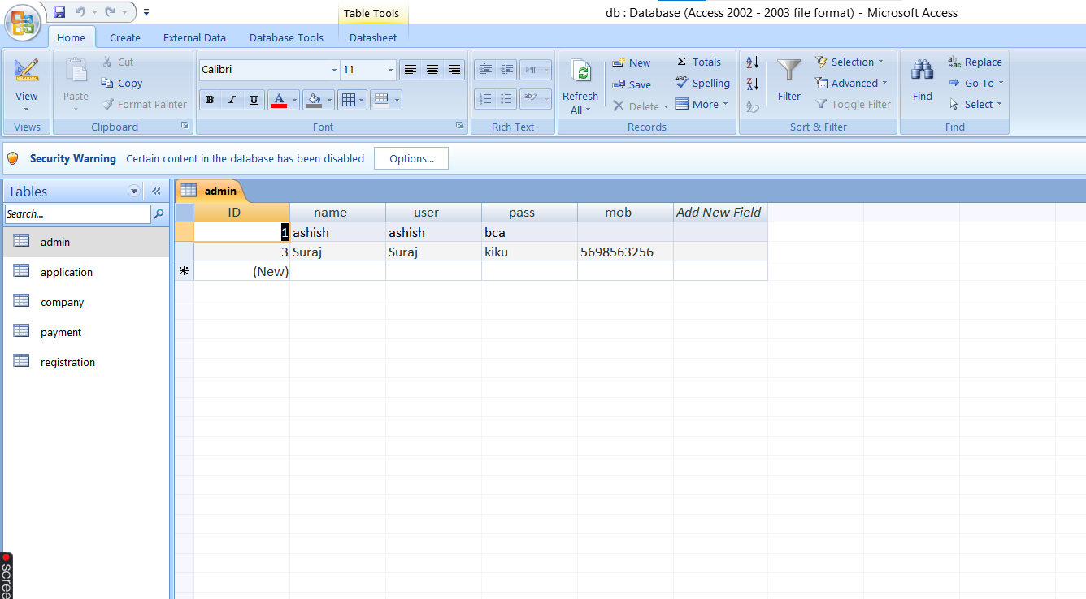
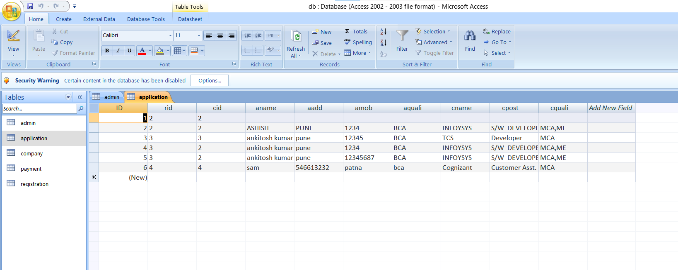
Some Data Dictionary
Login table
Application table

Slide 13
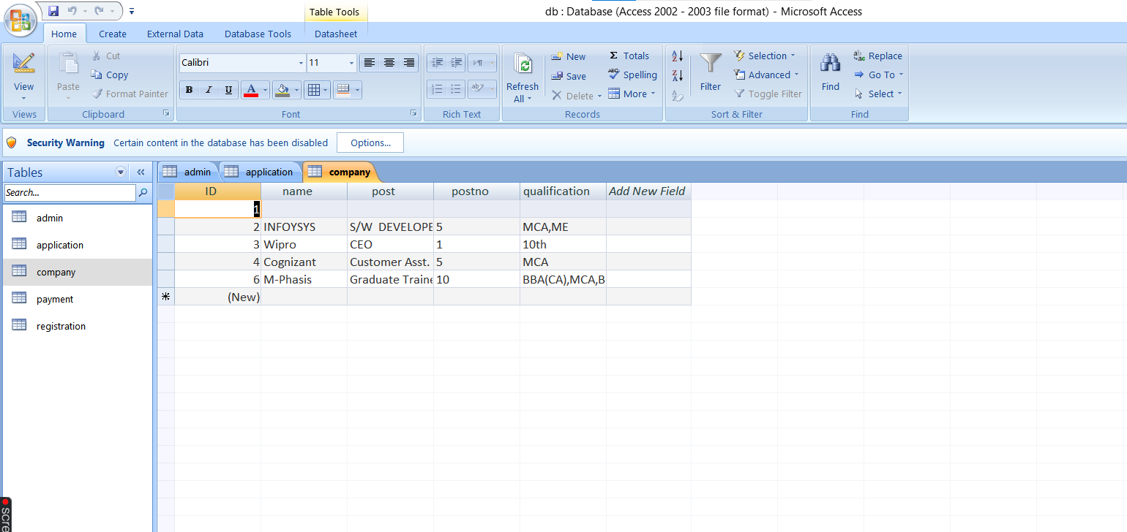
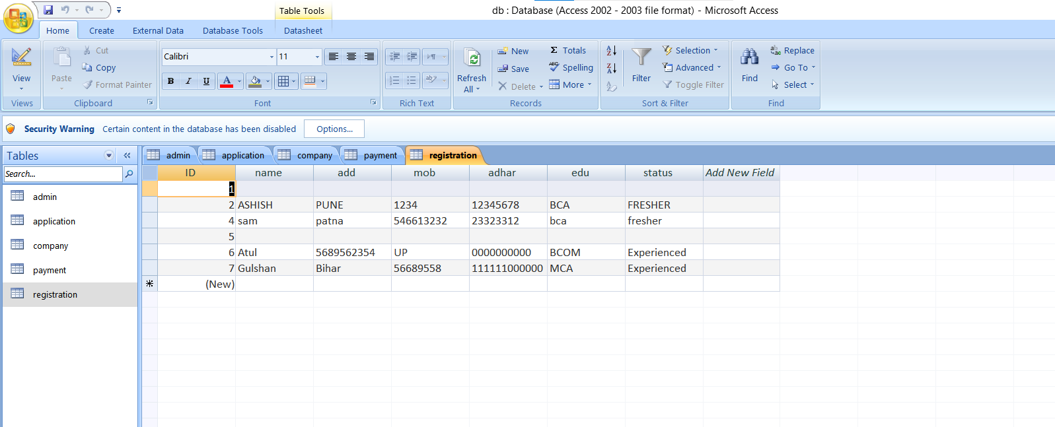
Company Table
Job Seeker Table

Slide 14
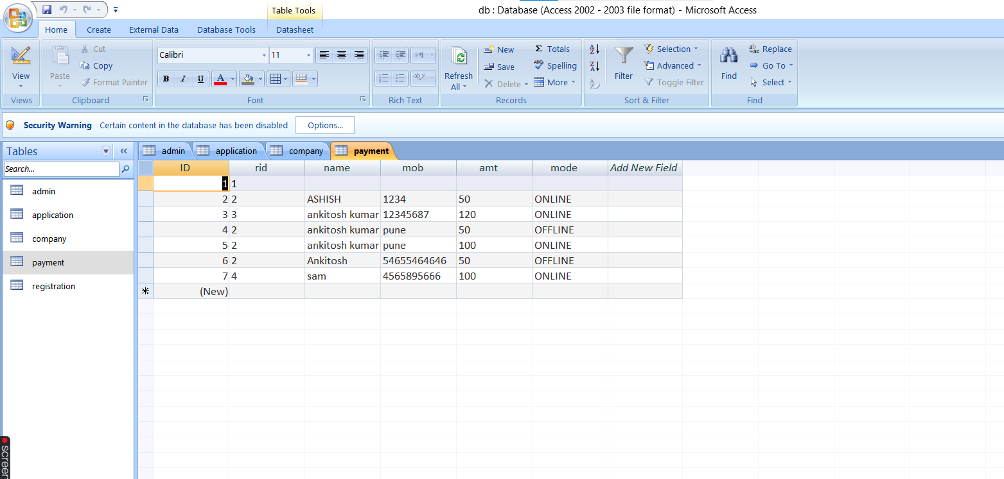
Payment Table

Slide 15
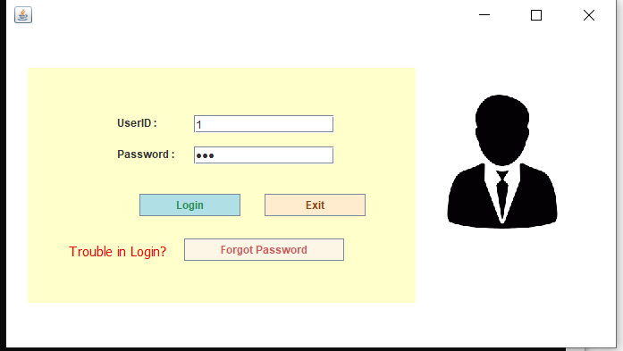
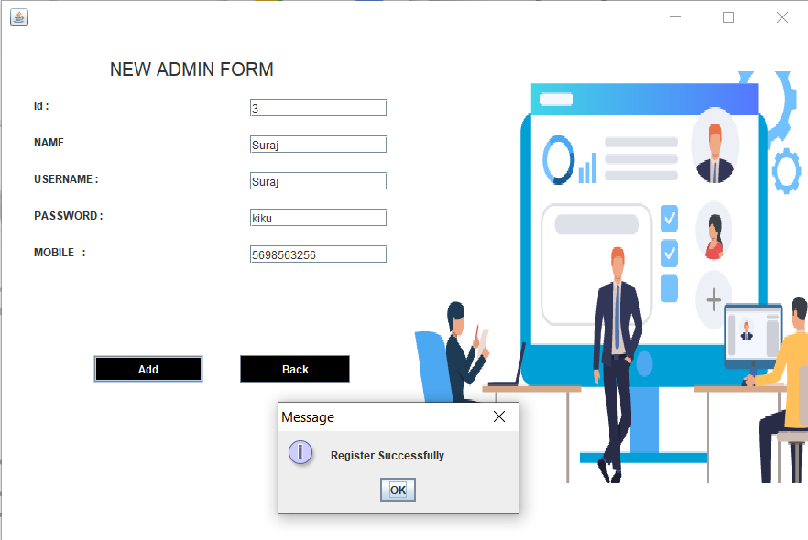
View of Some forms
Login Form
Registration Form

Slide 16
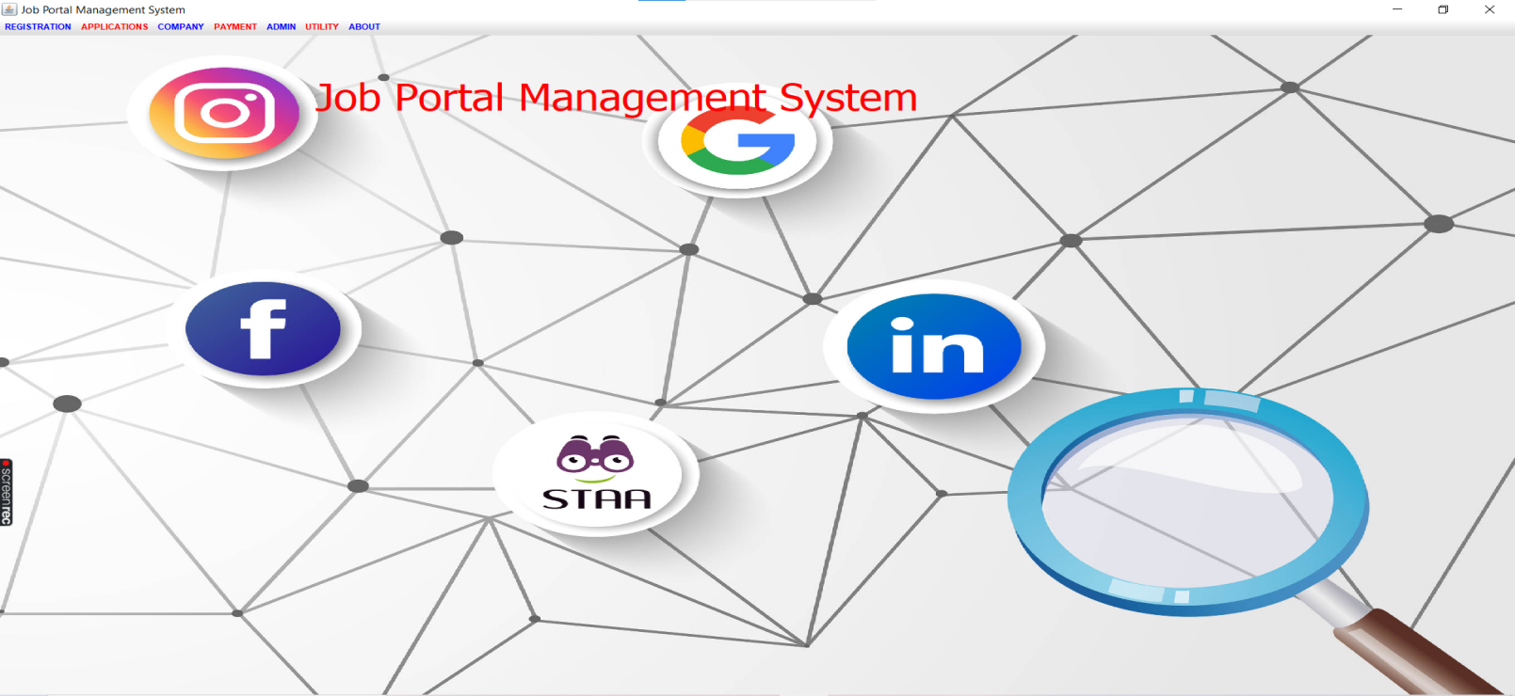
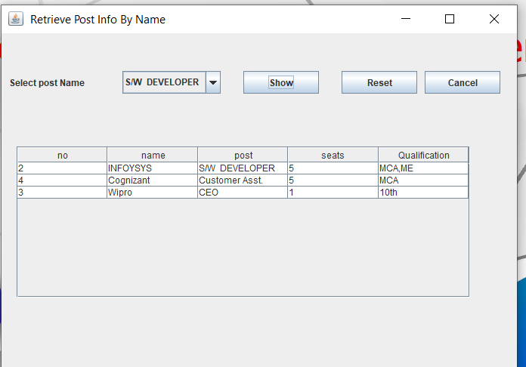
Home Page
Application View Form

Slide 17
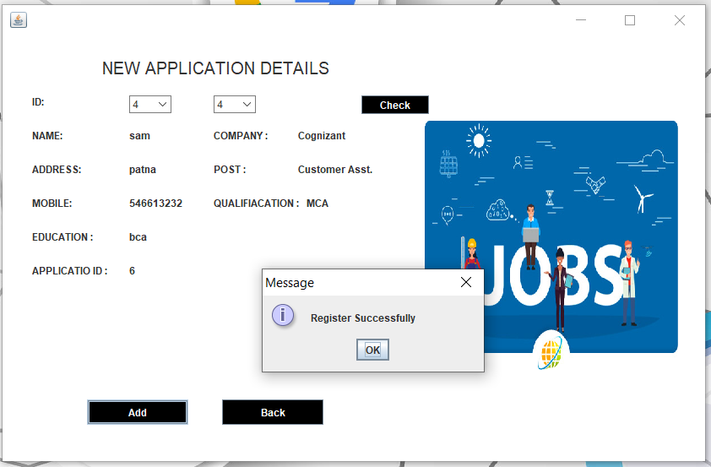
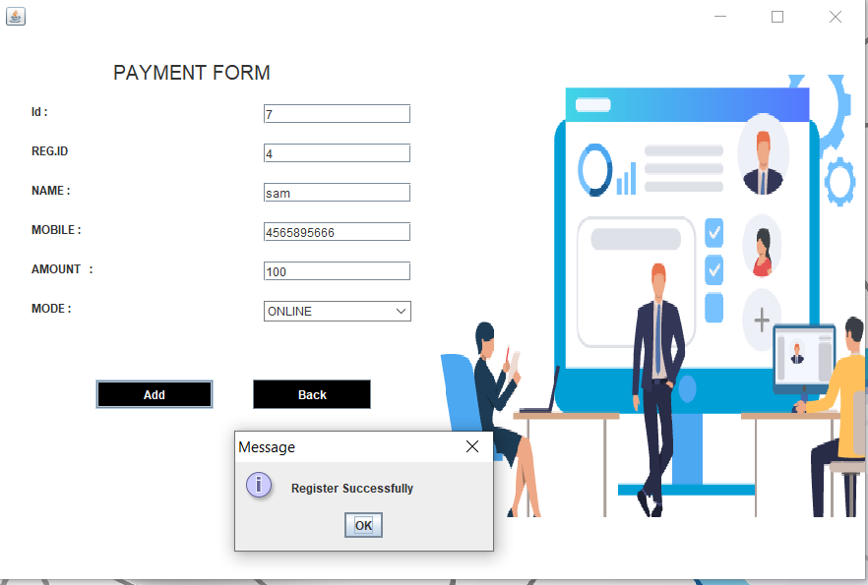
Company Registration Form
Payment Form

Slide 18
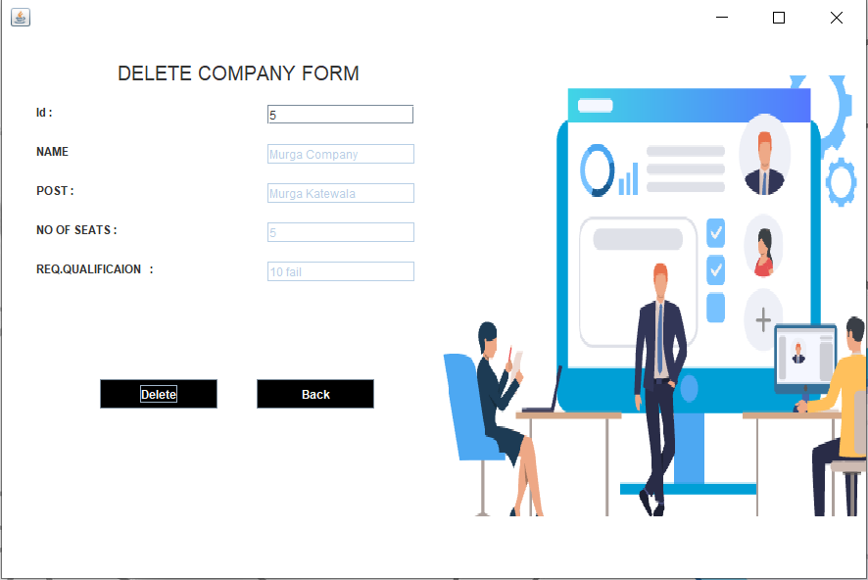
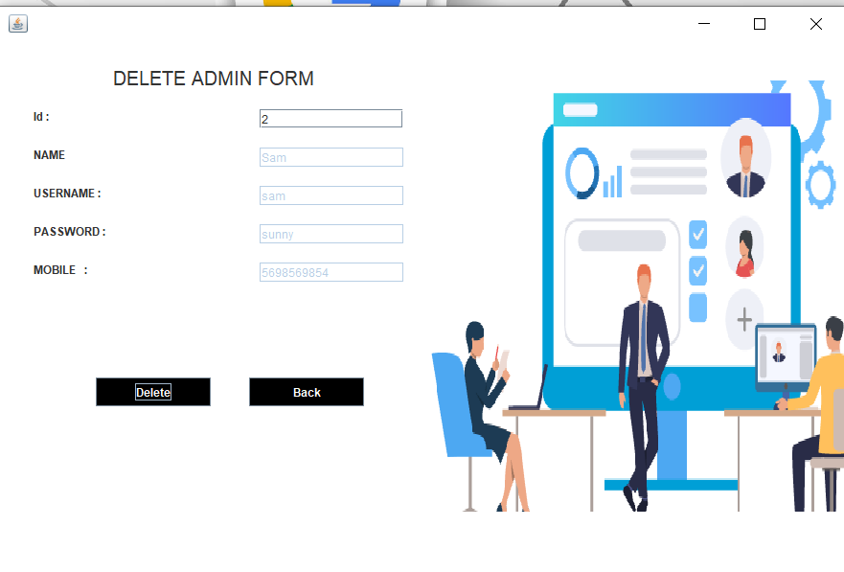
Delete Company Form
Delete Admin Form

Slide 19
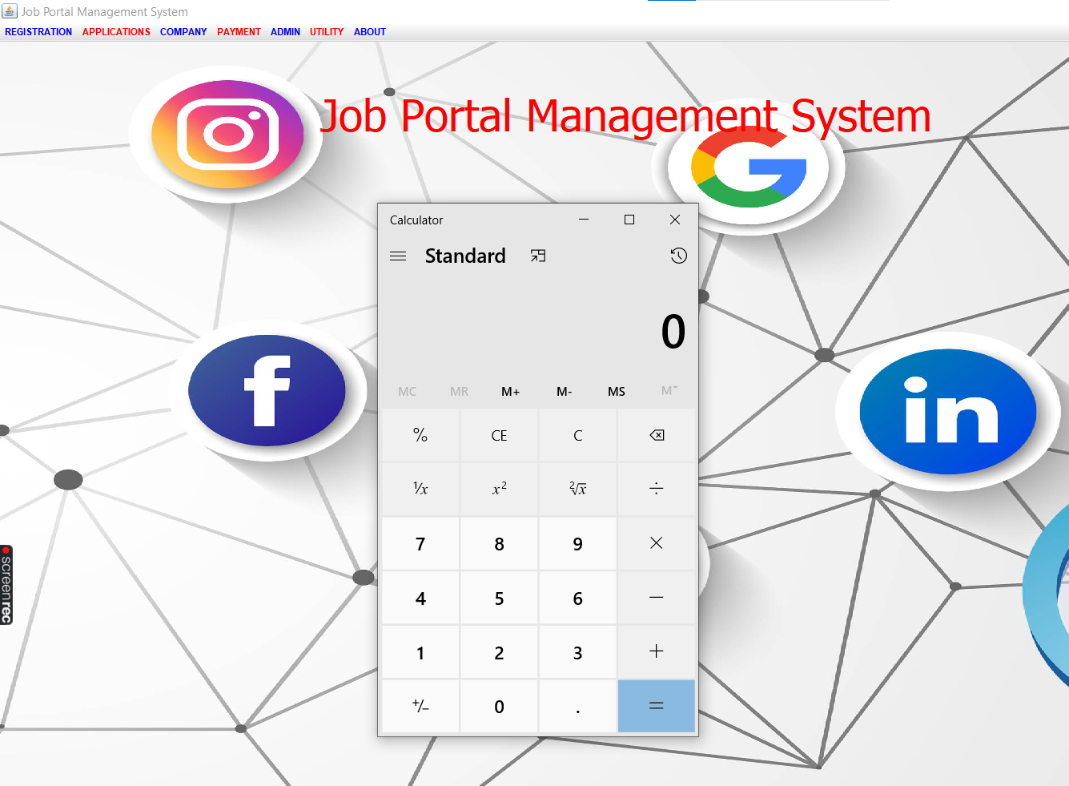
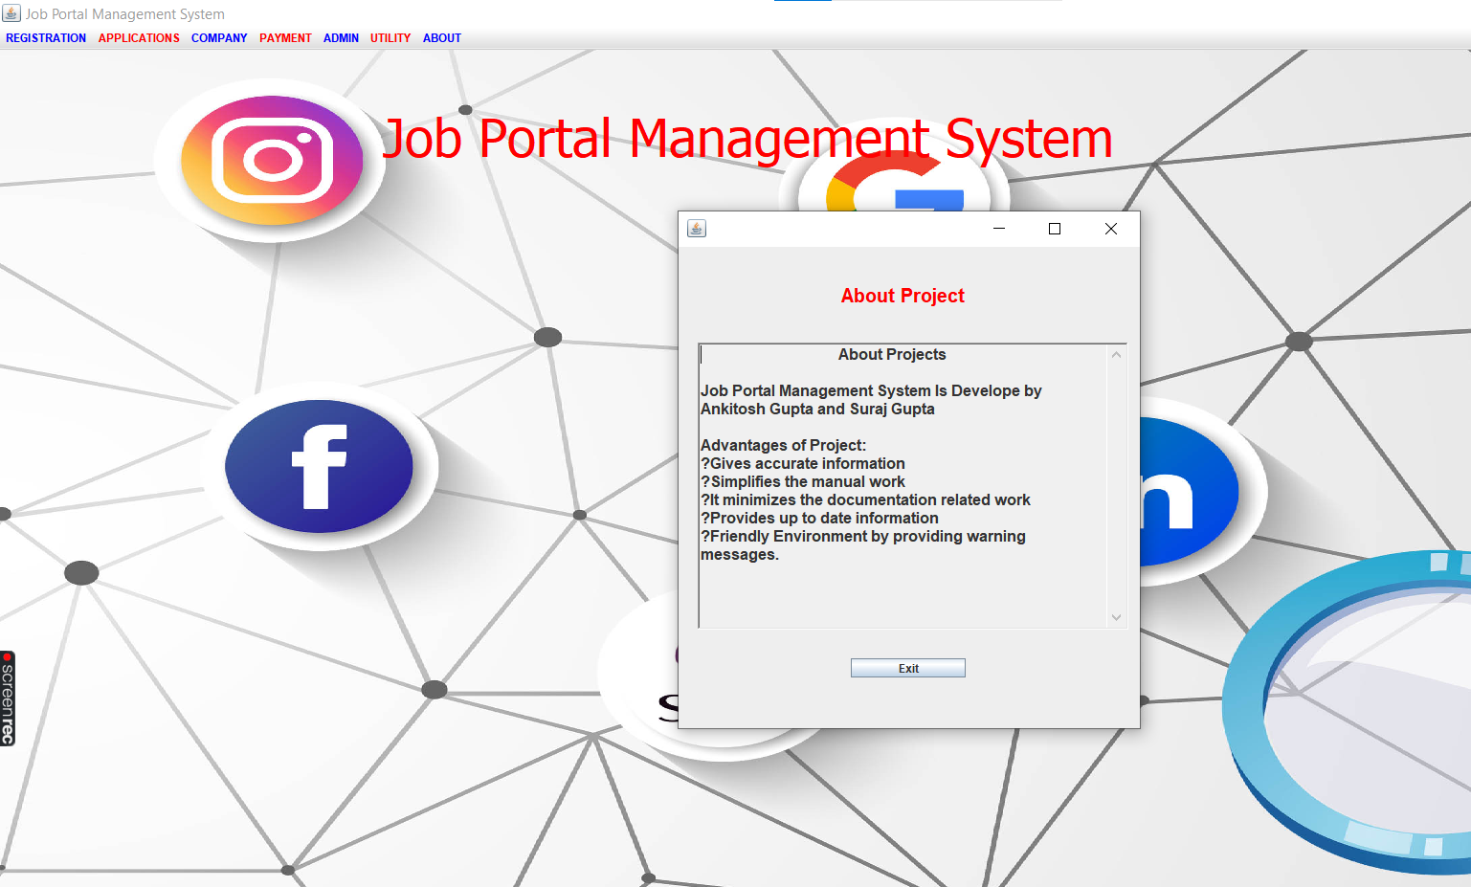
Utility Form
About Form

Slide 20
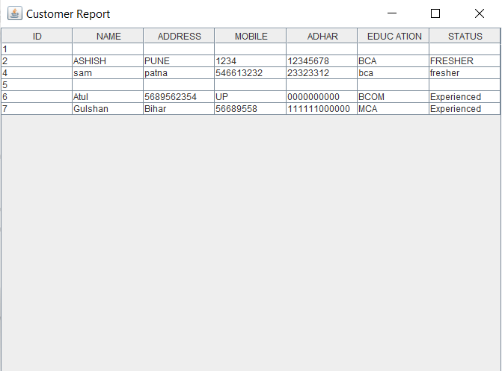
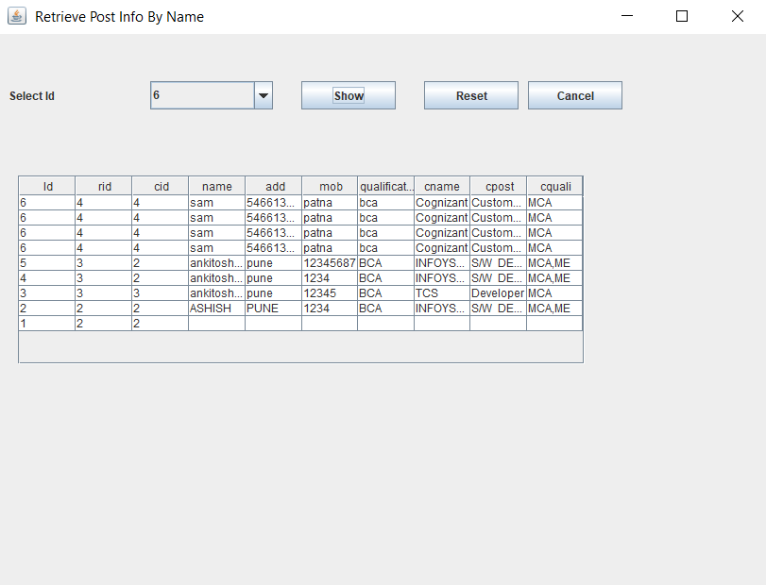
Some Reports

Slide 21
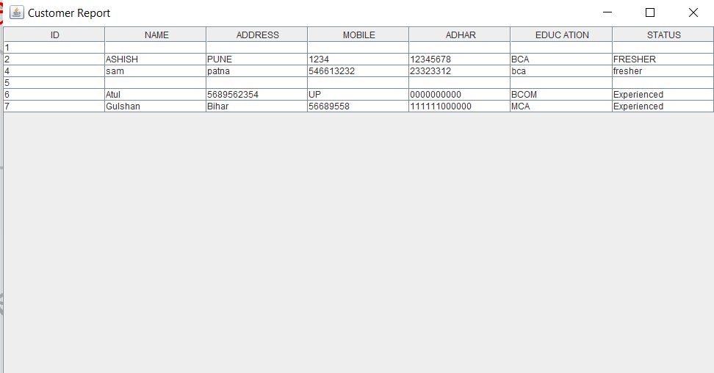
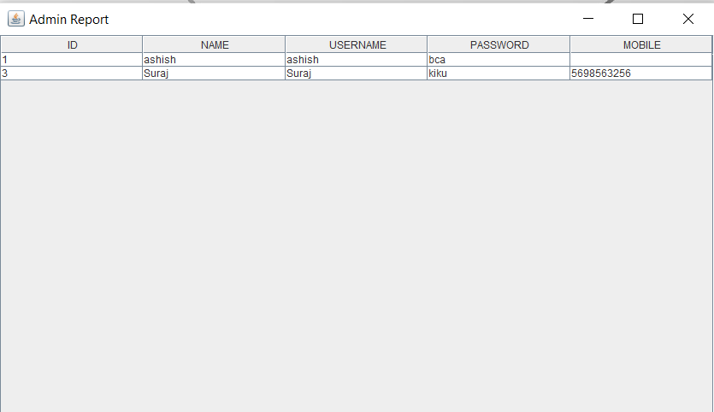

Slide 22
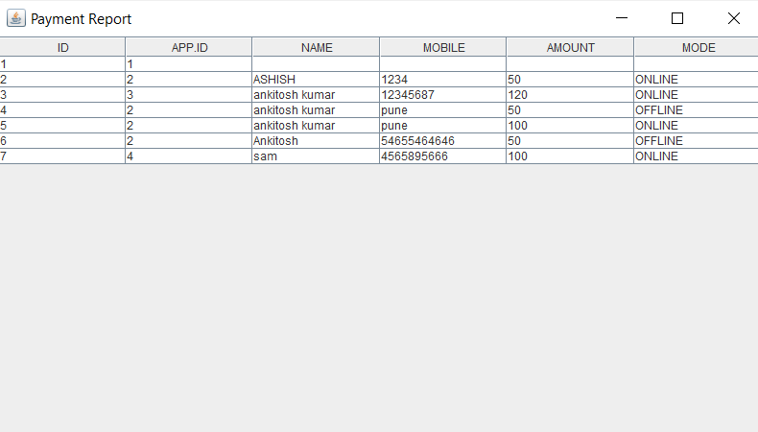

Slide 23
Advantage
As we discussed above about the examination system we attached whatever type of exam will be going to be held by an organization we attached that link throughout the account of the user.
The aim of proposed system is to develop a system of improved facilities.
The proposed system can overcome all the limitations of the existing system.
The system provides proper security and reduces the manual work.
Disadvantage
Project does not support an online system , so we cann’t operate it from somewhere else.
The software is only available for the admin and not the user.
The admin has the facility to operate the system.
Upgrading is main problem because for a offline application it is not possible to upgrade and upload it on server.
It can not handle by multiple users at a time.

Slide 24
Future Enhancement
This project can be enhanced further by developing an Online Website. Also we can develop a full-fledged accounting module. This software is flexible enough to be modified and implemented as per future requirements
Bibliography
Reference books:
1. Java2 – The Complete Reference
➢ Herbert Schildt
2. Core Java2 – Volume1 and 2
➢ Say S.Horstmann, Gary Cornell
3. Fundamental of Database Designs
➢ Elmasri and Navathe
Websites:
www.google.com
www.quora.com
www.wikipedia.com
www.javatpoint.com
www.tutorials.com

Slide 25
Thank You…

